Slide 1
Executive Summary Airline Safety
By: Tai Ngo
Date: 6/28/2020

Slide 2
Key Questions
Are Airlines still a safe way to travel?
Has the airline industry been improving the safety for their passengers?
How does air transportation compare to personal vehicle transportation in terms of safety?
Why is air transportation viewed as a dangerous way to travel?
How do major US airline companies perform recently despite the backlash from the media?
What is the trend of the sale tickets in the past few years?

Slide 3
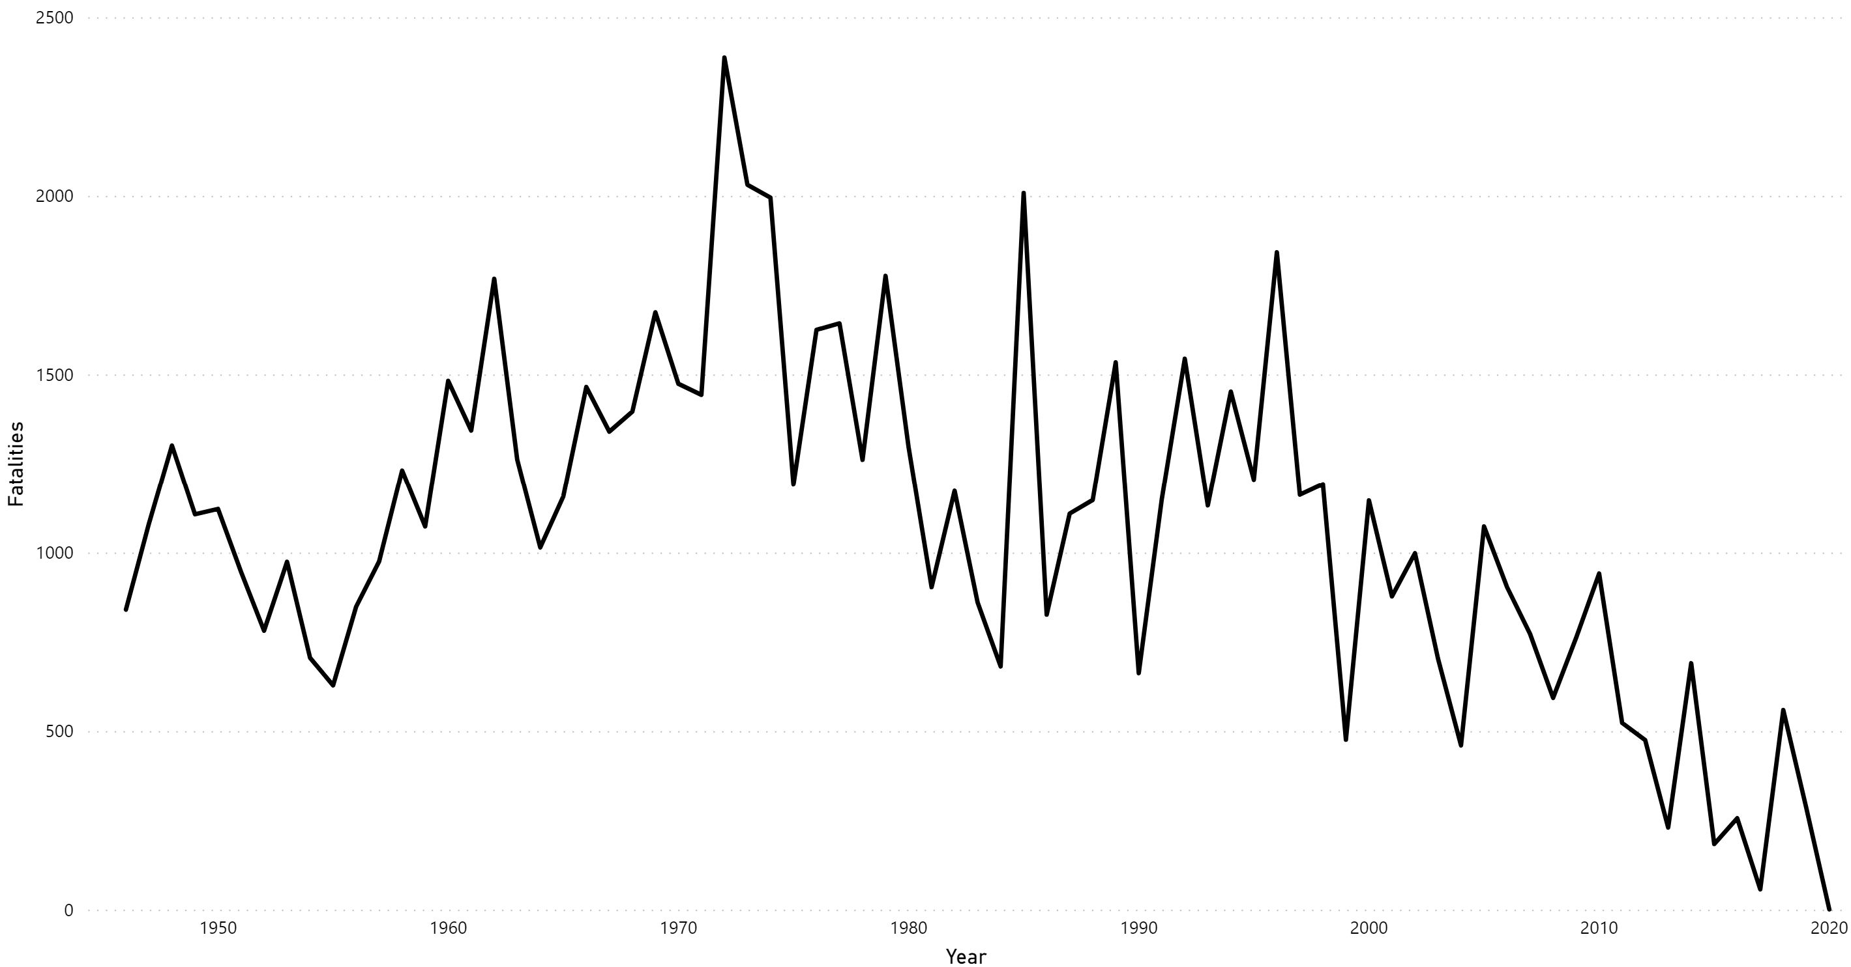
The Trend of Airline Safety

Slide 4
The Trend of Airline Safety
From 1950 to 2020, the amount of fatalities in the airline industry has been decreasing.
The trend line bounces up and down heavily, but the overall trend is on a decline.
Over the past 70 year, the average fatality is 1085 per year.
Over the last 10 years, the average fatality is 365 per year.

Slide 5
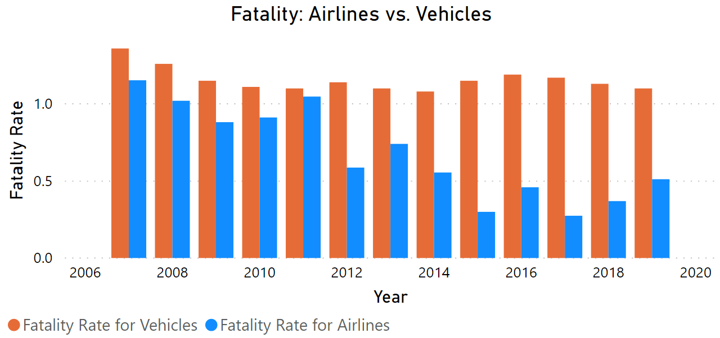
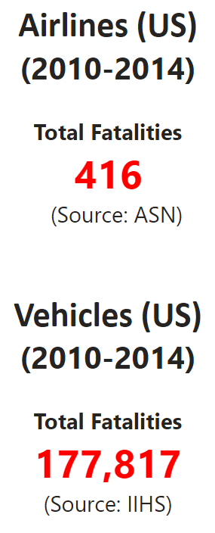
Airline’s and Vehicle’s Safety Comparison

Slide 6
Airline’s and Vehicle’s Safety Comparison
The comparison is based on the standard metrics to gauge the safety for airline and vehicle transportation.
The fatality rate for vehicle transportation is significantly higher than the fatality rate for airlines.
While the fatality rate for vehicles remains relatively unchanged, the fatality rate for airlines continues to decrease.
The fatality rate for vehicles is 427% higher than the fatality rate for airlines.
Airlines are safer to travel than automobile transportation.

Slide 7
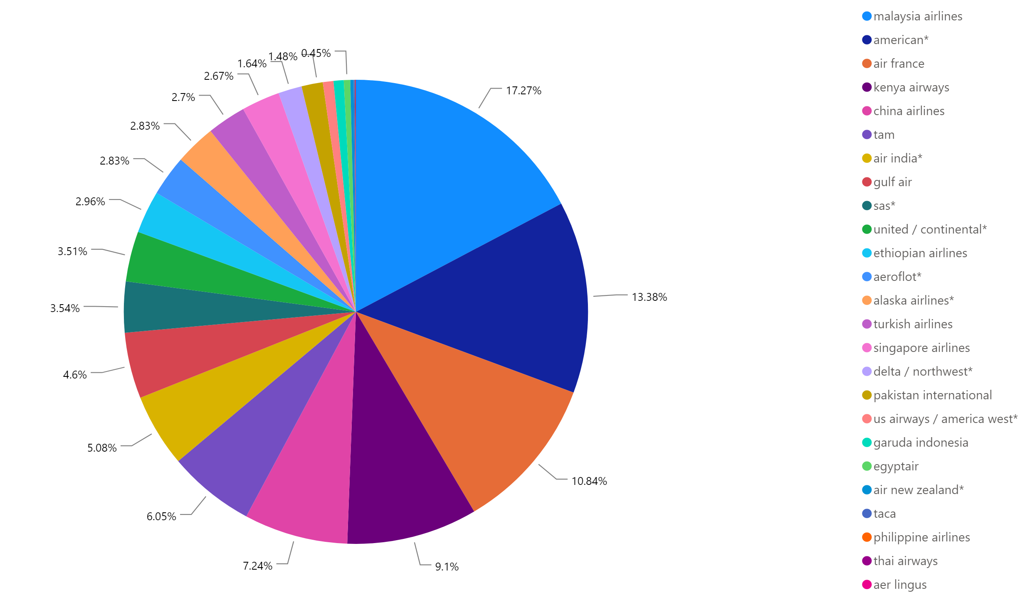
Fatalities between 2000 – 2014 by world’s airlines

Slide 8
Fatalities between 2000 – 2014 by world’s airlines
Malaysia airlines and US airlines have the highest amounts of fatalities from 2000 to 2014.
Malaysia airlines is an outlier for holding the highest fatalities because it has the highest fatalities despite its operations being five times smaller than the US airlines.
This outlier occurred due to a tragic disappearance of a Malaysian airplane, which caused 239 deaths in 2014. The outlier contributed significantly to the raise in the number of fatalities in 2014.

Slide 9
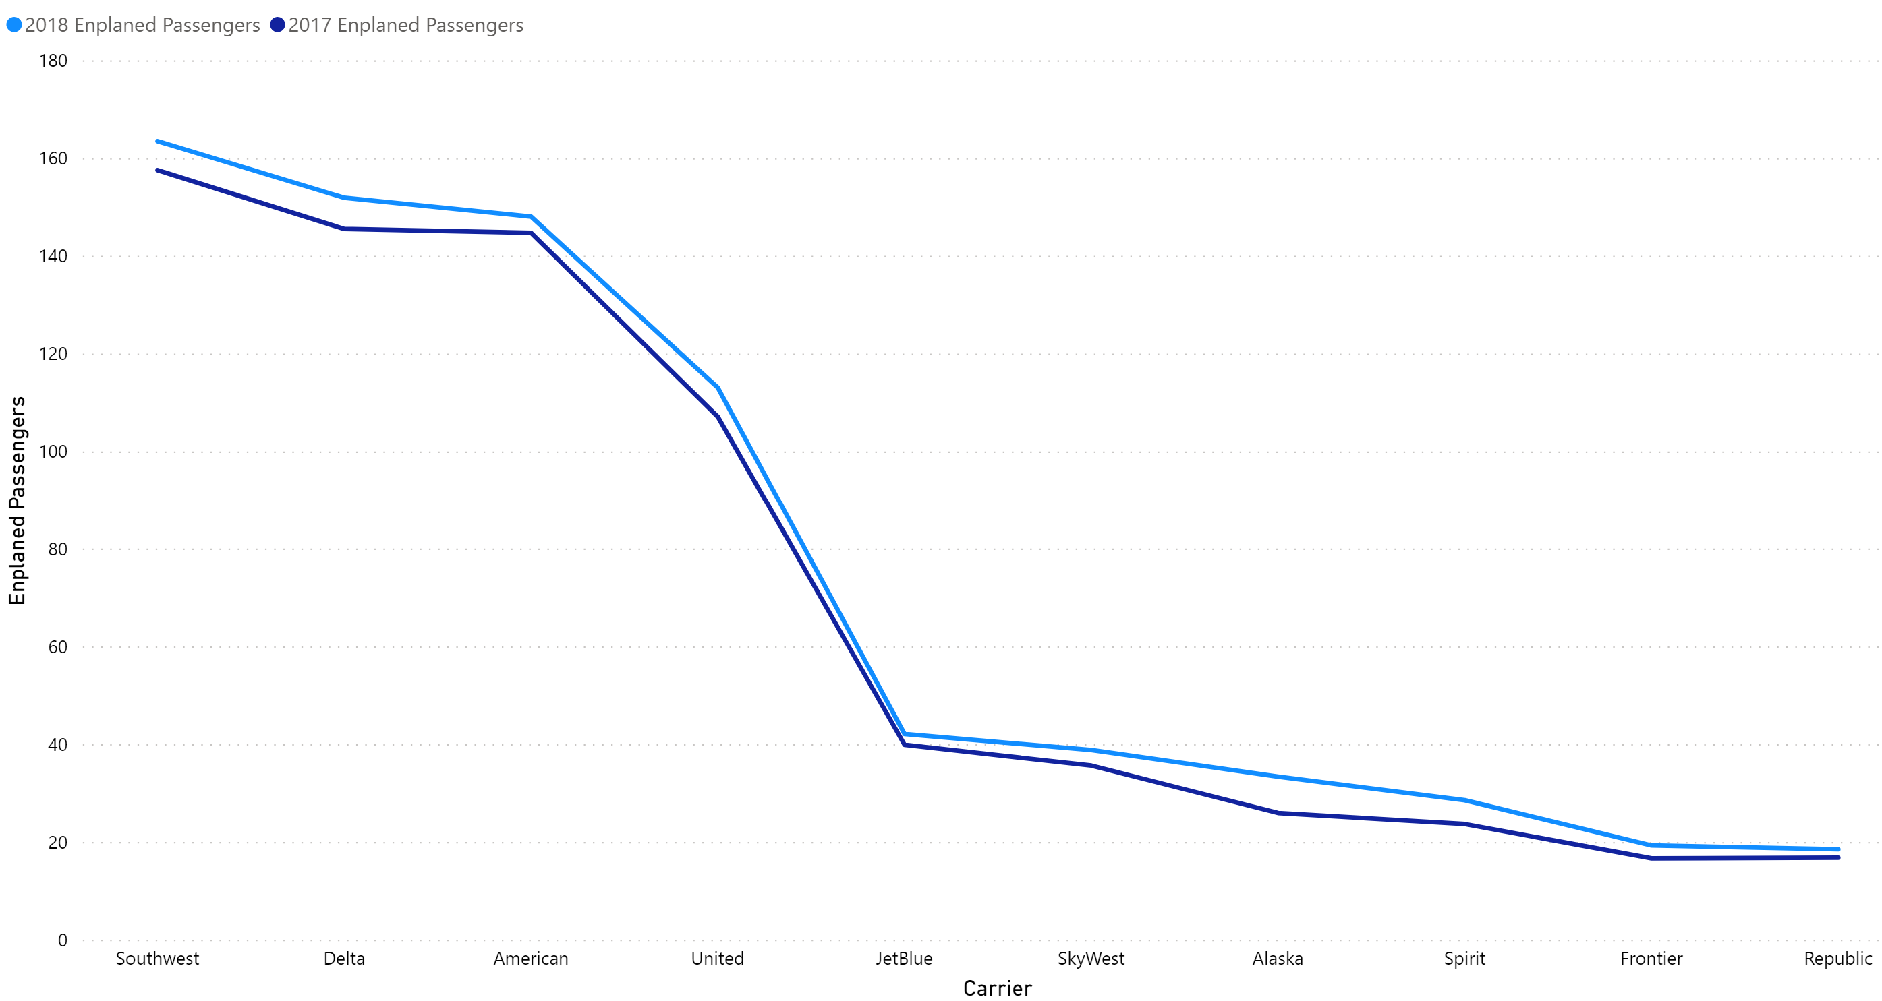
Major US Airlines

Slide 10
Major US Airlines
10 major US airlines see an increase in the number of passengers from 2017 to 2018 despite the news about the dangers in air transportation.
The most significant jumps are from Alaska, Delta and Southwest.
This data shows that the confidence of the US customers in airlines is still strong.

Slide 11
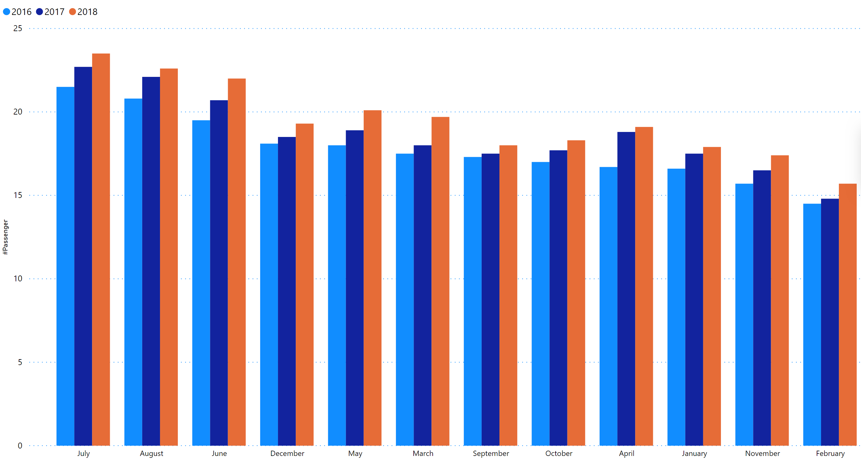
The Trend of Airline Ticket Sales

Slide 12
The Trend of Airline Ticket Sales
From 2016 to 2018, the airline ticket sales are trending up.
July, August and June see the most ticket sales.
This data shows that airlines are still a growing industry with higher sales year over year.

Slide 13
Addressing Key Questions
Airlines are still a safe way to travel despite the bad paintings from the media.
The safety of airlines is higher than the safety of automobile transportation.
The safety of airline has been increasing over years.
The spike in airline fatalities comes from an outlier, that rarely occurs and not the fault of the airline industry.
Major US airline companies are performing better as shown in the increase in ticket sales year over year.
The confidence of US passengers in the airlines remains strong.

